Slide 1
Memory management
Background

Slide 2
Introduction
Memory is central to the operation of a modern computer system. Memory consists of a large array of bytes, each with its own address.
The CPU fetches instructions from memory according to the value of the program counter. These instructions may cause additional loading from and storing to specific memory addresses.
A typical instruction-execution cycle, for example, first fetches an instruction from memory. The instruction is then decoded and may cause operands to be fetched from memory. After the instruction has been executed on the operands, results may be stored back in memory. The memory unit sees only a stream of memory addresses;

Slide 3
From where CPU fetches the data to operate on them ?
Main memory and the registers built into the processor itself are the only general-purpose storage that the CPU can access directly.
Any instructions in execution, and any data being used by the instructions, must be in one of these direct-access storage devices. If the data are not in memory, they must be moved there before the CPU can operate on them.

Slide 4
Registers
Registers are a type of computer memory used to quickly accept, store, and transfer data and instructions that are being used immediately by the CPU. The registers used by the CPU are often termed as Processor registers.
A processor register may hold an instruction, a storage address, or any data (such as bit sequence or individual characters).
The computer needs processor registers for manipulating data and a register for holding a memory address. The register holding the memory location is used to calculate the address of the next instruction after the execution of the current instruction is completed.
Register access can be done in one CPU clock (or less) . CPU can access its register directly within one CPU clock cycle. Completing a memory access may take many cycles of the CPU clock. In such a case the processor needs to stall since it does not have the data required to complete the instruction it is executing. Cache sits between main memory and CPU registers to deal with the “stall” issue.

Slide 5
Protection of memory is required to ensure correct operation:
Separate per process memory (range of legal access)
User process cannot access OS memory
One user process cannot access the memory of another user process.

Slide 6
Solution for protection of memory
We first need to make sure that each process has a separate memory space.
Separate per-process memory space protects the processes from each other and is fundamental to having multiple processes loaded in memory for concurrent execution.
To separate memory spaces, we need the ability to determine the range of legal addresses that the process may access and to ensure that the process can access only these legal addresses.
We can provide this protection by using two registers, usually a base and a limit.
The base register holds the smallest legal physical memory address; the limit register specifies the size of the range

Slide 7
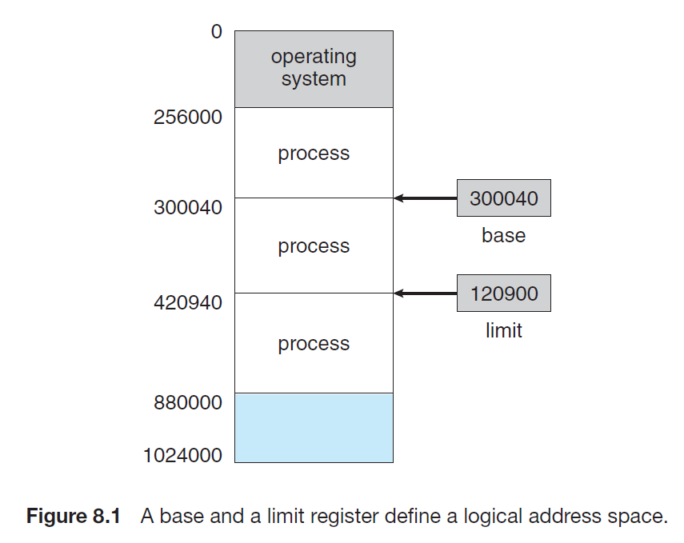

Slide 8
Memory protection
CPU must check that every memory access generated in user mode is between the base and base+limit for that user
Any attempt by a program executing in user mode to access operating-system memory or other users’ memory results in a trap to the operating system, which treats the attempt as a fatal error .
This scheme prevents a user program from (accidentally or deliberately) modifying the code or data structures of either the operating system or other users.

Slide 9
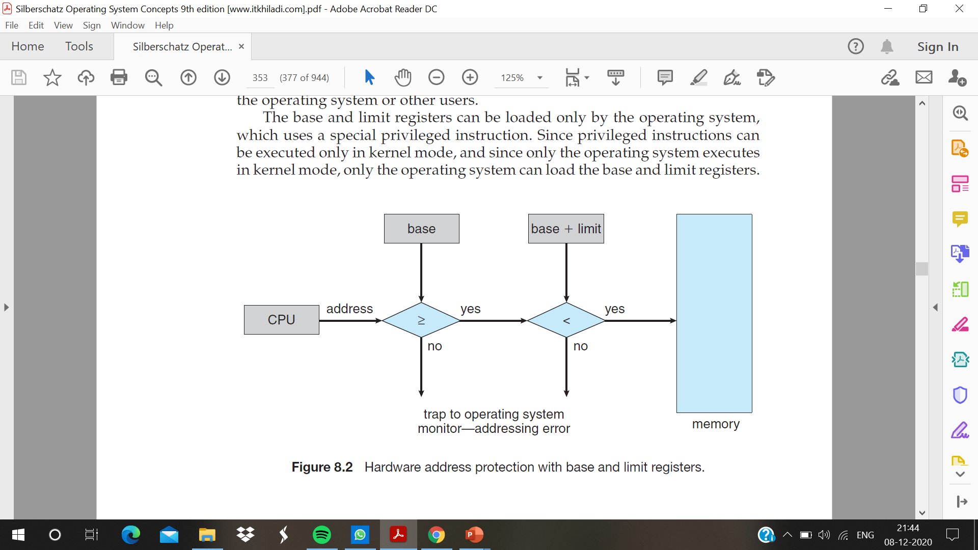
The base and limit registers can be loaded only by the operating system , which uses a special privileged instruction. Since privileged instructions can be executed only in kernel mode, and since only the operating system executes in kernel mode, only the operating system can load the base and limit registers.

Slide 10
Address Binding
a program resides on a disk as a binary executable file. To be executed, the program must be brought into memory and placed within a process.
Depending on the memory management in use, the process may be moved between disk and memory during its execution. The processes on the disk that are waiting to be brought into memory for execution form the input queue.
The normal single-tasking procedure is to select one of the processes in the input queue and to load that process into memory. As the process is executed, it accesses instructions and data from memory. Eventually, the process terminates, and its memory space is declared available.

Slide 11
In general, we do not know a priori where the program is going to reside in memory. Therefore, it is convenient to assume that the first physical address of a program always starts at location 0000.
Without some hardware or software support, program must be loaded into address 0000. Most (all) computer systems provide hardware and/or software support for memory management,
Addresses may be represented in different ways during these steps.
i) Addresses in the source program are generally symbolic (such as the variable count).
ii) A compiler typically binds these symbolic addresses to relocatable addresses (such as “14 bytes from the beginning of this module”).
iii) The linkage editor or loader in turn binds the relocatable addresses to absolute addresses (such as 74014).
iv) Each binding is a mapping from one address space to another.

Slide 12
Binding of Instructions and Data to Memory
Compile time : If memory location known a priori, absolute code can be generated; must recompile code if starting location changes. Eg: The MS-DOS .COM-format programs are bound at compile time.
Load time : If memory location is not known at compile time and no hardware support is available, relocatable code must be generated (If the starting address changes, we need only reload the user code to incorporate this changed value)
Execution time : If the process can be moved during its execution from one memory segment to another, then binding must be delayed until run time. Special hardware must be available for this scheme to work,. Most general-purpose operating systems use this method.

Slide 13
Logical Versus Physical Address Space
An address generated by the CPU is commonly referred to as a logical address, whereas an address seen by the memory unit—that is, the one loaded into the memory-address register of the memory—is commonly referred to as a physical address.
The compile-time and load-time address-binding methods generate identical logical and physical addresses. the execution-time address binding scheme results in differing logical and physical addresses.
The set of all logical addresses generated by a program is a logical address space. The set of all physical addresses corresponding to these logical addresses is a physical address space.

Slide 14
The run-time mapping from virtual to physical addresses is done by a hardware device called the memory-management unit (MMU).
The base register is now called a relocation register. The value in the relocation register is added to every address generated by a user process at the time the address is sent to memory.
For example, if the base is at 14000, then an attempt by the user to address location 0 is dynamically relocated to location 14000; an access to location 346 is mapped to location 14000+346 , that is 14346.
The user program never sees the real physical addresses. The program can create a pointer to location 346, store it in memory, manipulate it, and compare it with other addresses
Only when it is used as a memory address is it relocated relative to the base register. The user program deals with logical addresses. The memory-mapping hardware converts logical addresses into physical addresses.
There are two different types of addresses: logical addresses (in the range 0 to max) and physical addresses (in the range R + 0 to R + max for a base value R). The user program generates only logical addresses and thinks that the process runs in locations 0 to max.
The logical addresses must be mapped to physical addresses before they are used

Slide 15
Dynamic Loading
necessary for the entire program and all data of a process to be in physical memory for the process to execute. The size of a process has thus been limited to the size of physical memory. To obtain better memory-space utilization, we can use dynamic loading.
With dynamic loading, a routine is not loaded until it is called. All routines are kept on disk in a relocatable load format. The main program is loaded into memory and is executed.
When a routine needs to call another routine, the calling routine first checks to see whether the other routine has been loaded. If it has not, the relocatable linking loader is called to load the desired routine into memory and to update the program’s address tables to reflect this change. Then control is passed to the newly loaded routine.
The advantage of dynamic loading is that a routine is loaded only when it is needed. This method is particularly useful when large amounts of code are needed to handle infrequently occurring cases, such as error routines..
Dynamic loading does not require special support from the operating system. It is the responsibility of the users to design their programs to take advantage of such a method.

Slide 16
Dynamic Linking and Shared Libraries
Dynamically linked libraries are system libraries that are linked to user programs when the programs are run
Some operating systems support only static linking, in which system libraries are treated like any other object module and are combined by the loader into the binary program image.
Dynamic linking is similar to dynamic loading. linking, rather than loading, is postponed until execution time.
The stub is a small piece of code that indicates how to locate the appropriate memory-resident library routine or how to load the library if the routine is not already present.
When the stub is executed, it checks to see whether the needed routine is already in memory. If it is not, the program loads the routine into memory.
Either way, the stub replaces itself with the address of the routine and executes the routine. Thus, the next time that particular code segment is reached, the library routine is executed directly.
Dynamic linking is particularly useful for libraries System also known as shared libraries

